Slide 1


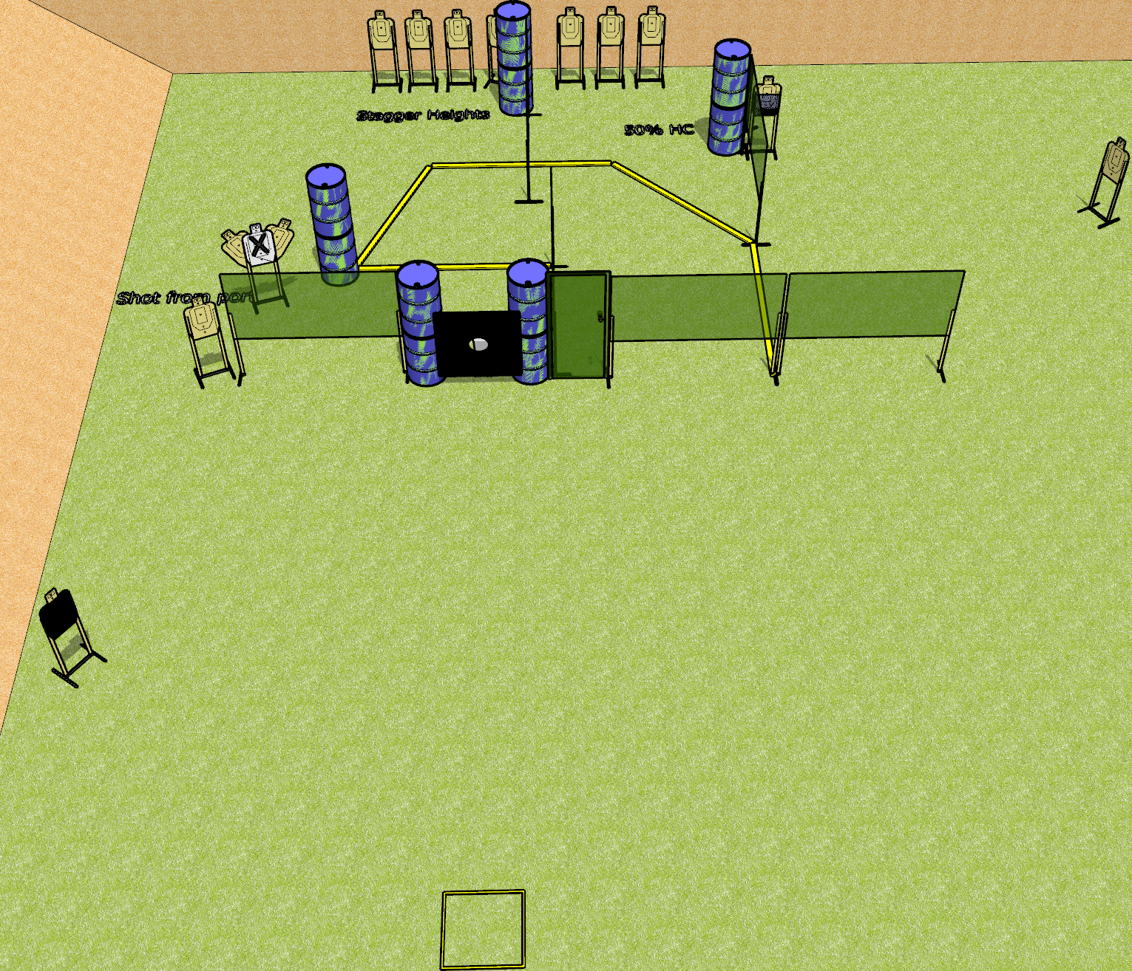
 | Dothan Gun Club – USPSA Match Door Kicker Course Designer : Drew Coleman
Round Count 29 rounds 14 USPSA targets 1 pepper popper
Equipment List 11 wall feet Big plate with hole in it + 2 stands Door 2 50%, 1 headshot NOTE: targets with NS on the left should be angled to port
Port

Slide 2
Door Kicker
Written Stage Briefing
Door Kicker is a 23 round, 115 point, Comstock course of fire. There are 12 USPSA targets and 1 pepper popper. The best 2 hits on paper will score, and steel must fall to score. The start signal is audible.
The door is “locked” with an activator that is activated by the pepper popper. Please check the activator prior to walkthrough and set it the same way every time.
Handgun start position is in start box, wrists below belt. Handgun is loaded and holstered.
PCC start position is in start box. Loaded carbine is held with both hands, stock on belt, safety on.
On start signal engage targets as they become available from within the shooting area.

